Slide 1





DATAVISTA: Sales Data Analysis and Visualization
Team:
Gagankumar Seth gaganseth2102@gmail.com
Himanshi Nagori himanshinagori.wit@gmail.com
Chavi Maru chavimaru19@gmail.com
Guide: Mr. Vignesh Muthuvelan
Disclaimer: The content is curated for educational purposes only.
Notes:
Slides: Prepare a short slide deck (10-12 slides) summarizing the project objectives, methodology, and key results.

Slide 2
DATAVISTA: Sales Data Analysis and Visualization
OUTLINE
Abstract of the Project
Problem Statement
Proposed Solution
System Architecture
Live Demo of the Project
Embedded Video of Project
Conclusion
Future Scope

Slide 3
Abstract
DATAVISTA: Sales Data Analysis and Visualization
The DataVista project analyses supermarket sales data to uncover patterns and insights, helping businesses optimize sales strategies. It leverages Python, Pandas, NumPy, Matplotlib, Seaborn, and Scikit-learn for data processing and visualization.

Slide 4
Problem Statement
DATAVISTA: Sales Data Analysis and Visualization
Businesses struggle with sales trends, customer behaviour, product performance, and payment preferences, leading to ineffective strategies. Limited predictive analysis hampers sales forecasting and customer satisfaction improvements.

Slide 5
Proposed Solution
DATAVISTA: Sales Data Analysis and Visualization
Data Preprocessing: Handling missing values, converting data types, and scaling numerical features.
Exploratory Data Analysis (EDA): Using visualizations (bar plots, pie charts, line graphs) to uncover sales trends and customer behavior.
Statistical Analysis: Conducting correlation and regression analysis to predict sales based on unit price and quantity sold.
Data Splitting & Scaling: Standardizing data using Min-Max Scaling, Z-score normalization, and Decimal Scaling.

Slide 6
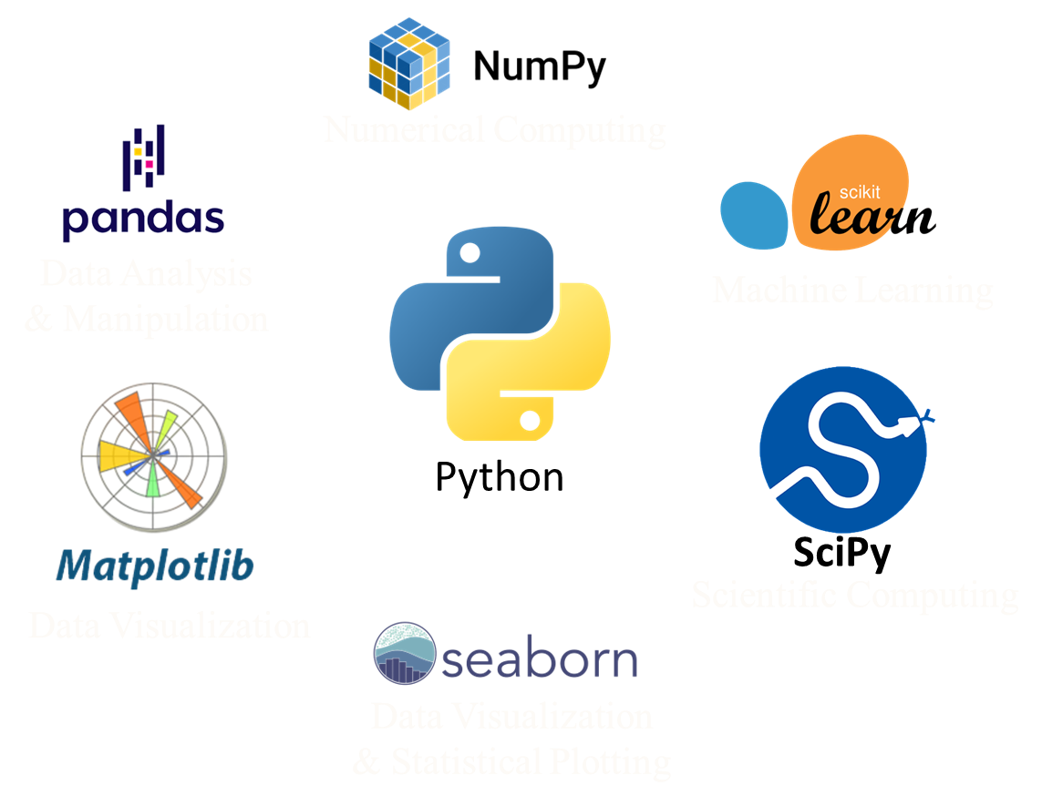

System Architecture
DATAVISTA: Sales Data Analysis and Visualization
Data Collection: Sales data from supermarket transactions.
Preprocessing Module: Cleansing, handling missing values, and transforming data.
EDA Module: Graphical analysis to visualize sales insights.
Statistical Analysis Module: Correlation, regression, and predictive modeling.
Visualization & Insights Dashboard: Displaying key metrics like sales distribution, customer demographics, and gross income trends.

Slide 7
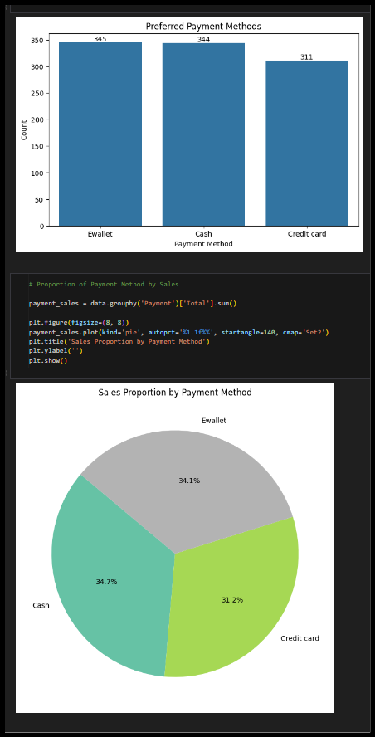
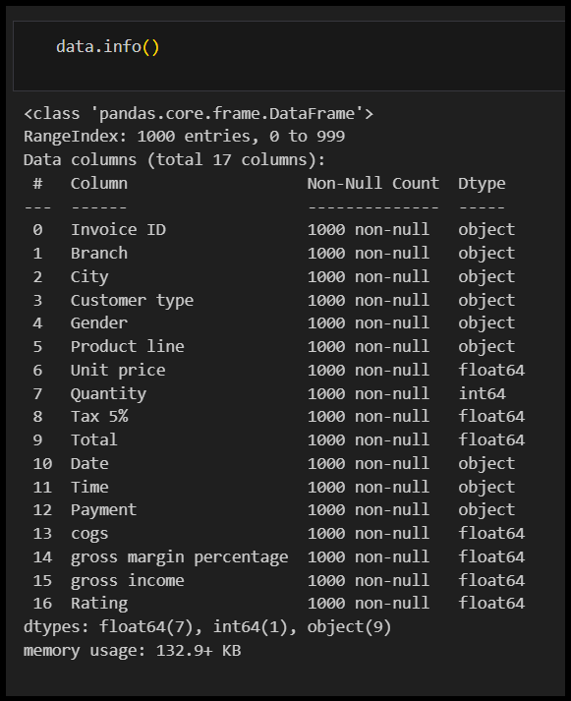
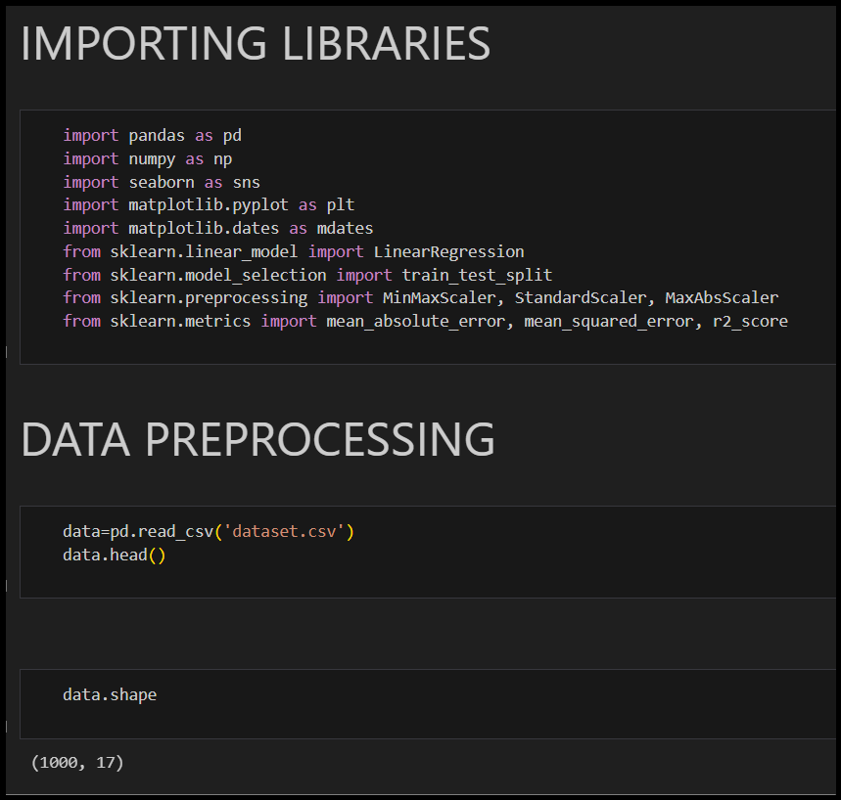
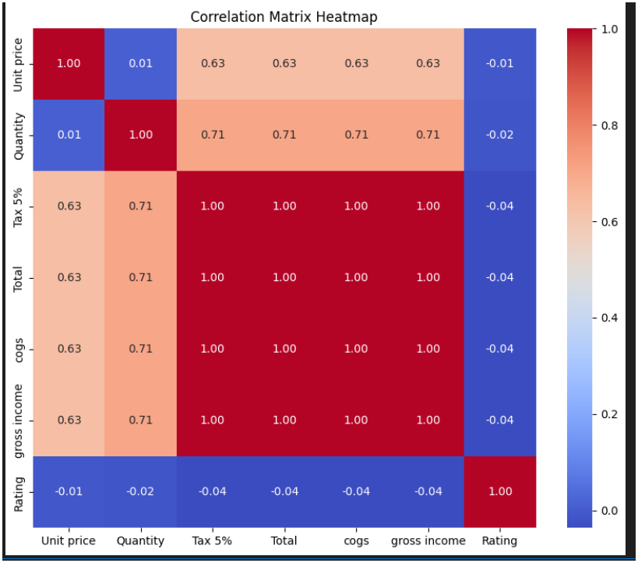
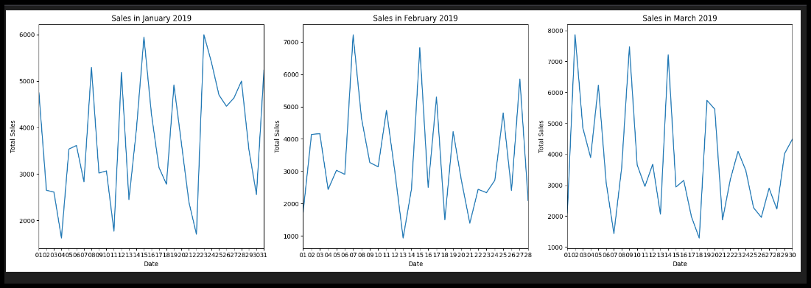
Live Demo of Project
DATAVISTA: Sales Data Analysis and Visualization
Project Link

Slide 8
DATAVISTA: Sales Data Analysis and Visualization
Video of Project Demo
https://drive.google.com/file/d/1E27OALdxEF_Emzao4_ImajnLx8lN5b7P/view?usp=sharing

Slide 9
Conclusion
DATAVISTA: Sales Data Analysis and Visualization
DataVista provides actionable insights into sales trends, customer behaviour, and revenue factors.
Businesses can optimize inventory, pricing, and marketing strategies using data-driven decisions.
The project enhances efficiency, profitability, and customer satisfaction through predictive analysis.

Slide 10
Future Scope
DATAVISTA: Sales Data Analysis and Visualization
Implement real-time data analysis for immediate sales trend tracking.
Develop an interactive dashboard with predictive analytics.
Integrate AI-based recommendation systems for sales forecasting.
Expand analysis to include external market factors like competitor pricing and economic trends.

Slide 11
Thank you!
Notes:
thank you very much for joining this PPT, keep learning.
11

